Slide 1
AMP: Does it Really Make Your Site Faster?
Nigel Heron + Nic Jansma

Slide 2



Nigel Heron
@querymetrics
Nic Jansma
@nicj
https://slideshare.net/nicjansma/amp-does-it-really-make-your-site-faster
https://github.com/querymetrics/amp-analytics-demo

Slide 3
What is AMP?
Accelerated Mobile Pages (AMP):
A way to build websites optimized for performance
Restricts how you build your pages to achieve this
Components:
AMP HTML: Similar to HTML5, but with restrictions
AMP JavaScript: JavaScript library you include
Google AMP Cache: Free CDN for AMP pages
Notes:
OS project
Google has a dedicated team to pushing it forward
Malte's talk from yesterday

Slide 4
What is AMP?
What you can include:
Text (with custom fonts)
Images
Video
Ads
Third-party embeds (tweets, posts, etc)
Notes:
ads, images, carousel, facebook, youtube, vine, vimeo, twitter, sound cloud, pinterest, instagram

Slide 5
What is AMP?
What you can’t include:
External CSS
JavaScript (except AMP JavaScript library)
Flash / Java applets
Forms and Inputs are experimental
Notes:
https://www.ampproject.org/docs/reference/extended/amp-form.html

Slide 6
Why AMP: Performance
What could performance mean for mobile devices?
Faster load time
Less bandwidth usage
Less memory usage
Less CPU usage
Less battery usage
Better user experience

Slide 7
Why AMP: Performance
AMP enforces a lot of best practices:
Async script loading
CSS inline to avoid blocking font downloads
CSS size limit
Element dimensions are mandatory
Notes:
extra functionality is loaded with extensions that won’t be fetched unless you add them
50k CSS size limit

Slide 8
Why AMP: Performance
Built-in performance:
Prioritized resource loading
Prerender aware (instant load)
Caching CDN (HTML, JavaScript, images, fonts)
JavaScript resources shared by all AMP pages
Notes:
extra functionality is loaded with extensions that won’t be fetched unless you add them

Slide 9
Why AMP: Business
AMP is smart for businesses:
Google is prioritizing AMP in web and native app search results on mobile devices
Support for ads (over 60 vendors)
High-speed global caching CDN -- free of charge
Notes:
add more?

Slide 10
Why AMP: Developers
AMP pages are easy to develop:
If you know HTML, you know AMP
WordPress plugins available that automatically create AMP pages
Built in validator helps developers reduce bugs
Good documentation and examples
Need a new feature? Open a Pull Request

Slide 11
Why AMP: CDN
Free CDN:
HTTPS (HTTP/2, QUIC or SPDY)
Supports HTTP or HTTPS origin servers
Throttled cache revalidation
Image cache with image optimization for mobile
Notes:
https://developers.google.com/amp/cache/overview
haven’t seen the cdn replace links with AMP versions
stale content served, background refreshes

Slide 12
Why AMP: CDN
Free CDN:
Font cache (4 whitelisted font providers)
Rewrite font and image src to point to CDN
HTML sanitization
AMP validation
Notes:
https://developers.google.com/amp/cache/overview
haven’t seen the cdn replace links with AMP versions

Slide 13
Measuring AMP Performance
How we measure traditional websites doesn’t work for AMP:
Web server logs or APM:
Only gives server-side performance
Doesn’t work with AMP Cache (CDN)
JavaScript on the page or external JavaScript:
Not allowed

Slide 14
Measuring AMP Performance
How we measure traditional websites doesn’t work for AMP:
JavaScript in an IFRAME:
Sandboxed (RUM data unavailable)
Synthetic monitoring:
Works, but doesn’t tell the RUM story

Slide 15


Synthetic Monitoring
Great for A/B comparing AMP vs. non-AMP
Non-AMP
AMP

Slide 16
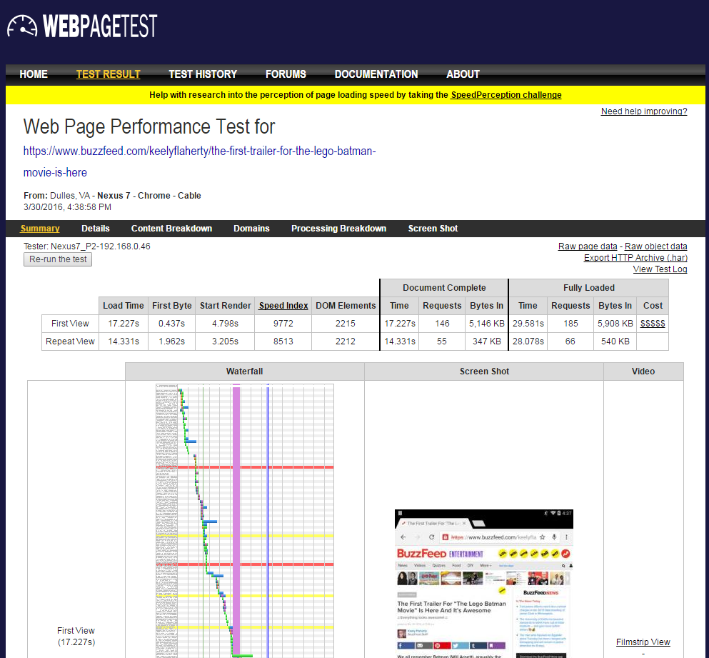
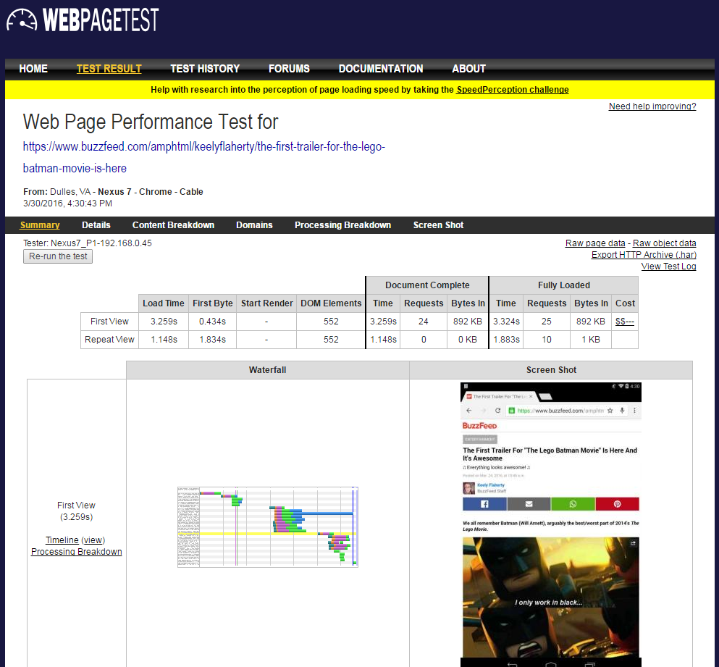
Synthetic Monitoring
Non-AMP
AMP

Slide 17
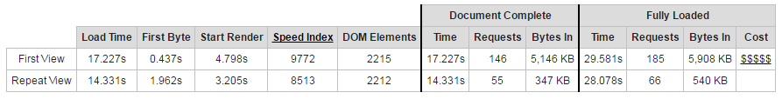
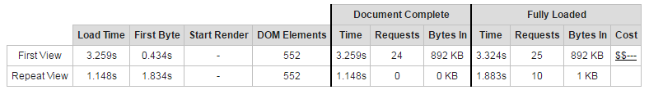
Synthetic Monitoring
Non-AMP
29.5s
5.9mb
AMP
3.3s
0.8mb

Slide 18
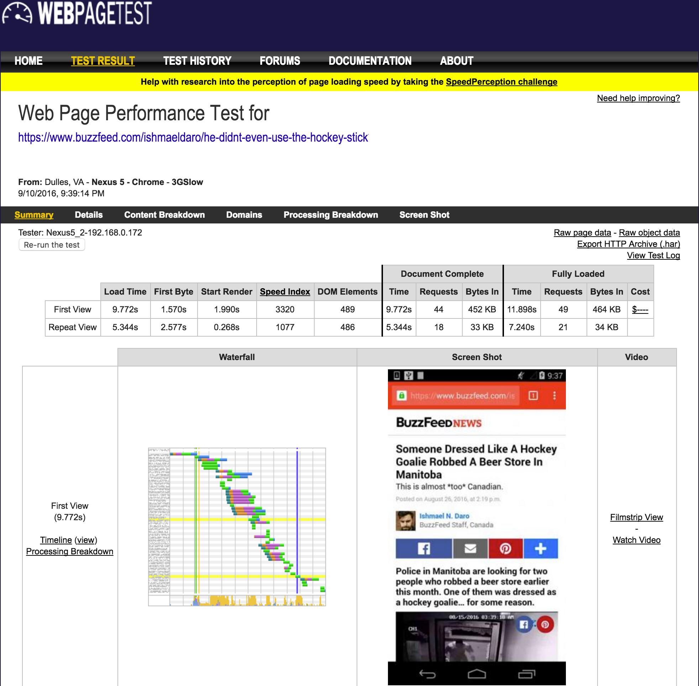
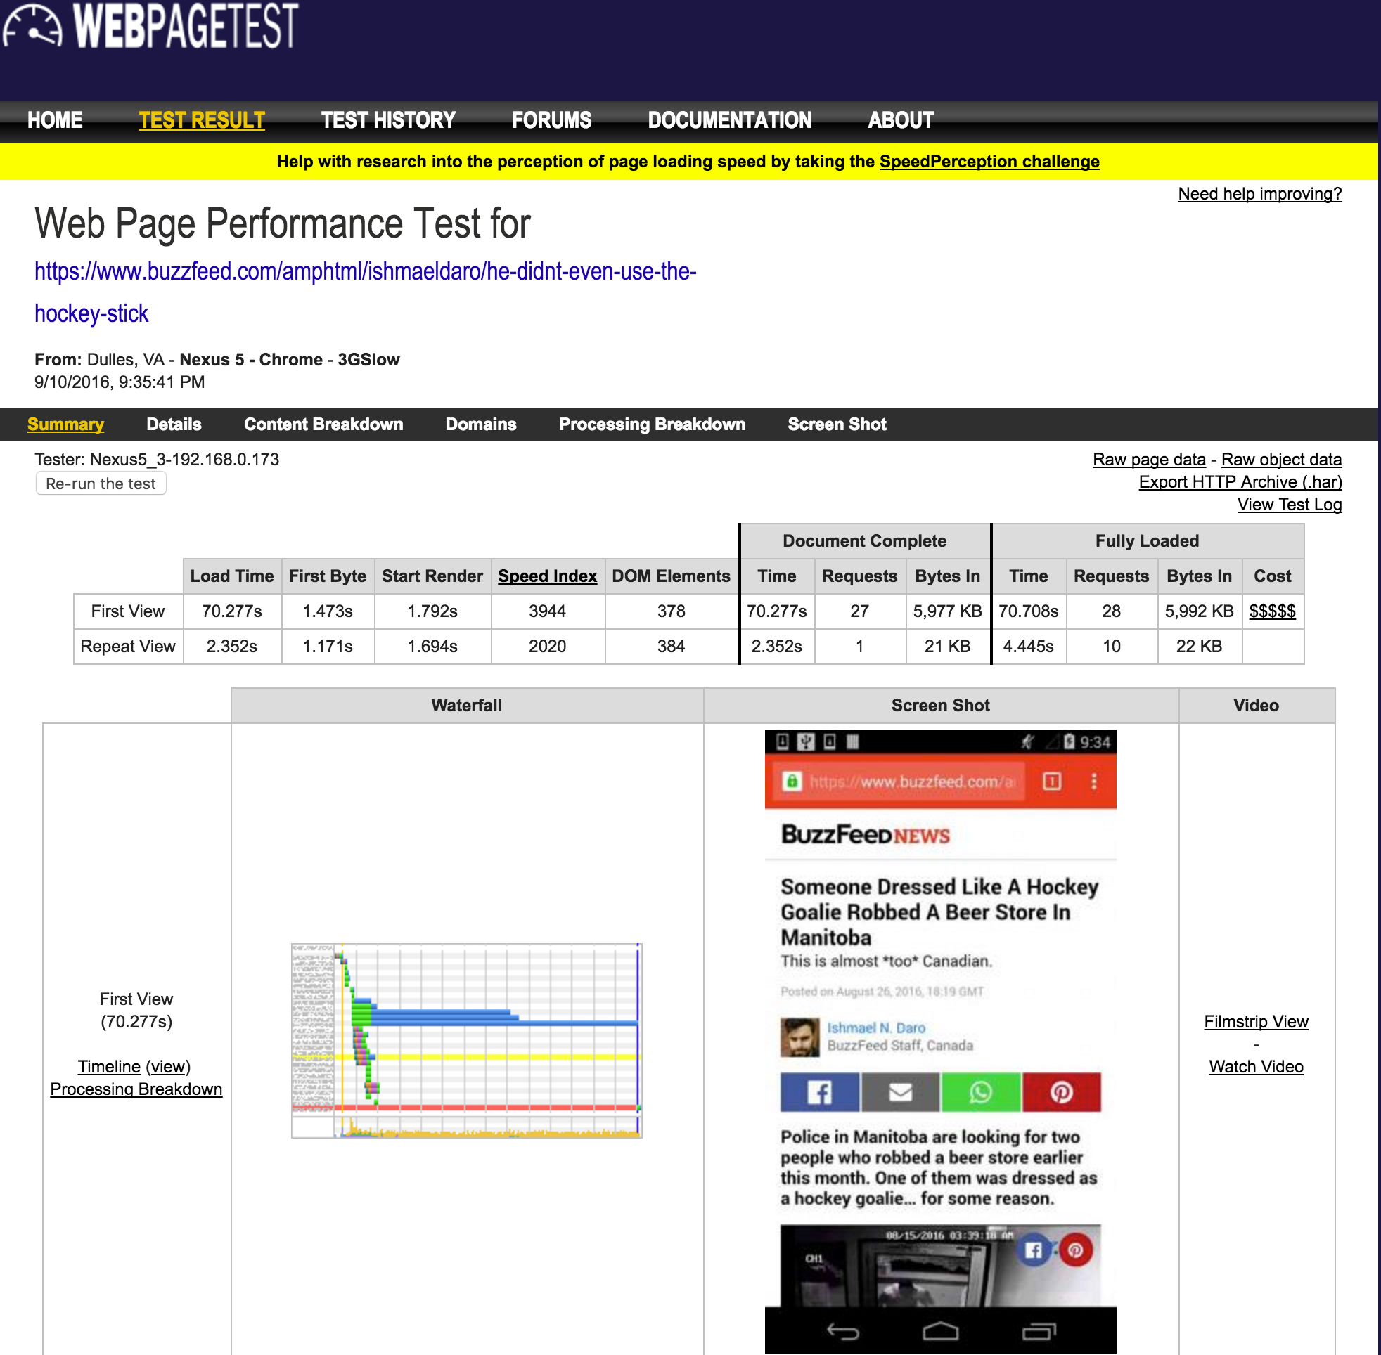
Synthetic Monitoring
Non-AMP
AMP
Notes:
due to animated gif in AMP,
AMP page is layed out and text is viewable without jank as pics come in

Slide 19
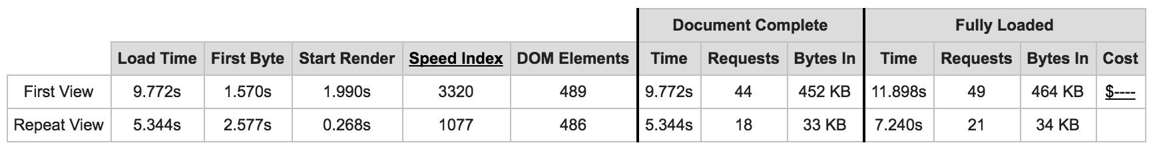
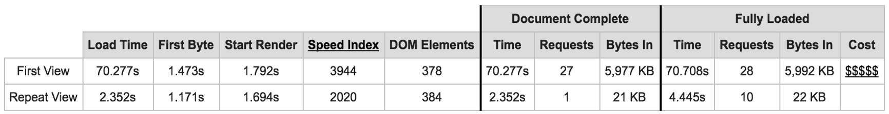
Synthetic Monitoring
Non-AMP
11.8s
0.4mb
AMP
70.7s
5.9mb

Slide 20
Synthetic Monitoring
AMP is not a guarantee of performance.
Test Test Test!

Slide 21
Synthetic Monitoring
Downsides:
Doesn’t tell you how things are performing live
Hard to estimate traffic patterns
Is not Real User Monitoring (RUM)
Controlled environment ( != real world / devices)
Notes:
refactor this, RUM in downsides?

Slide 22
Measuring AMP Performance
Q: How do we collect RUM data without custom JavaScript?
A: We don’t, it’s built in!

Slide 23
<amp-pixel>: Overview
<amp-pixel src="https://[your-url]">
GET query URL
Substitution variables to gather metrics
No extra extension download required
Triggered during page layout
Because it's not tied to visibility, perf data might not be available

Slide 24
<amp-pixel>: Example
<amp-pixel src="http://my-server.com/beacon? url=${canonicalUrl}&title=${title}">

Slide 25
<amp-pixel>: Variable Substitution
Many variable available:
Document info (URL, canonical URL, title, referer)
Navigation Timing (TCP, DNS, SSL, page load, etc)
Navigation type and redirect count
Persisted Client ID
Total Engaged Time
Screen/viewport dimensions
https://github.com/ampproject/amphtml/blob/master/spec/amp-var-substitutions.md

Slide 26
<amp-pixel>: User identification
AMP has a Client ID:
Managed by AMP
Saved via cookie
Required because content may be from publisher's domain or AMP Cache
amp-[base64 random]

Slide 27
<amp-analytics>: Vendor
If you don't want to roll-your-own, there's <amp-analytics>:
Available as an extension
Over 25 built in vendor configs
Easy to configure
Predefined list of metrics is sent to vendor
Notes:
Mention vendors like GA, mPulse and that you'd just include your API key or something

Slide 28
<amp-analytics>: DIY
<amp-analytics> <script type="application/json"> [config] </script>
</amp-analytics>
Harder to configure but customizable
Can send metrics to your own server
Variable substitution
GET or POST
Configurable trigger events

Slide 29
<amp-analytics>: Triggers
When will a beacon be sent?
on visible / on hidden
Page
AMP element (time, percentage)
on click (CSS selector)
on scroll (horizontal, vertical percentage)
on timer (interval)

Slide 30
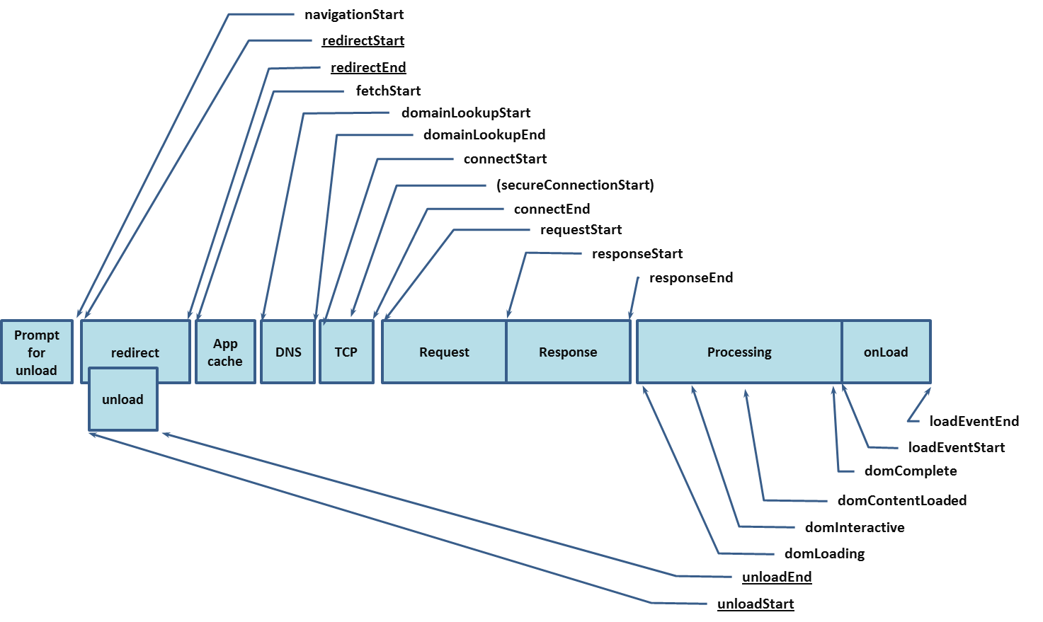
Measuring AMP Performance
navTiming(navigationStart) navTiming(responseStart, responseEnd)
Notes:
nav timing data, resource timing soon
Dataset that can be gathered is predefined in AMP.
[Our contributions]

Slide 31
<amp-analytics>: DIY
<amp-analytics> <script type="application/json">
{
"requests": {
"onvisible":"//my-server.com/beacon?u=${sourceUrl}
&load=${navTiming(navigationStart,loadEventStart)}"
},
"triggers": {
"onvisible": {
"on": "visible",
"request": "onvisible"
}
}
}
</script></amp-analytics>

Slide 32
AMP: Live Demo
https://amp.querymetrics.com/
DIY RUM dashboard
<amp-analytics> tag sends beacon from AMP page
Node.js: Web server receives beacon from AMP page and forwards to DB
InfluxDB: Time series DB that stores Navigation Timing data from beacon
Grafana: Dashboard to view aggregated data
Notes:
http://querymetrics.com:3000/dashboard/db/amp-demo-dashboard
http://amp.querymetrics.com/
https://cdn.ampproject.org/c/amp.querymetrics.com/

Slide 33
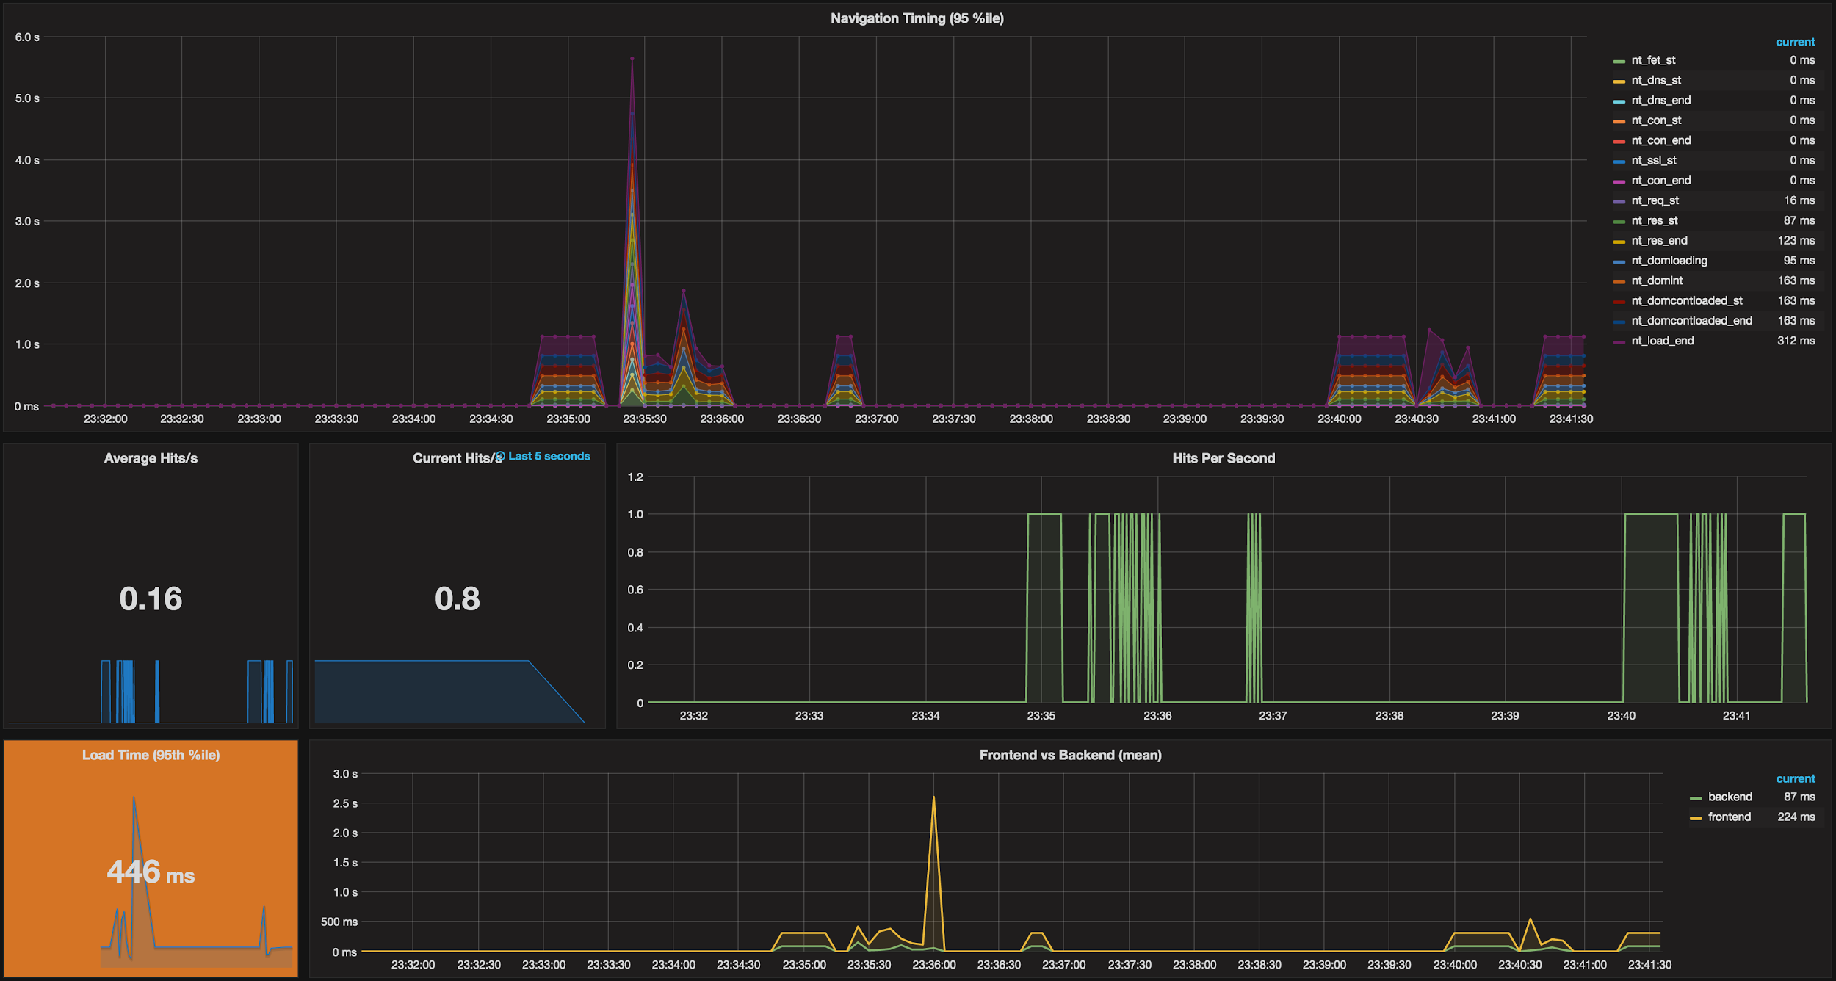
AMP: DIY RUM Dashboard
Notes:
http://querymetrics.com:3000/dashboard/db/amp-demo-dashboard
http://amp.querymetrics.com/
https://cdn.ampproject.org/c/amp.querymetrics.com/

Slide 34
AMP Real-World Data
How are AMP pages performing in the real world?

Slide 35
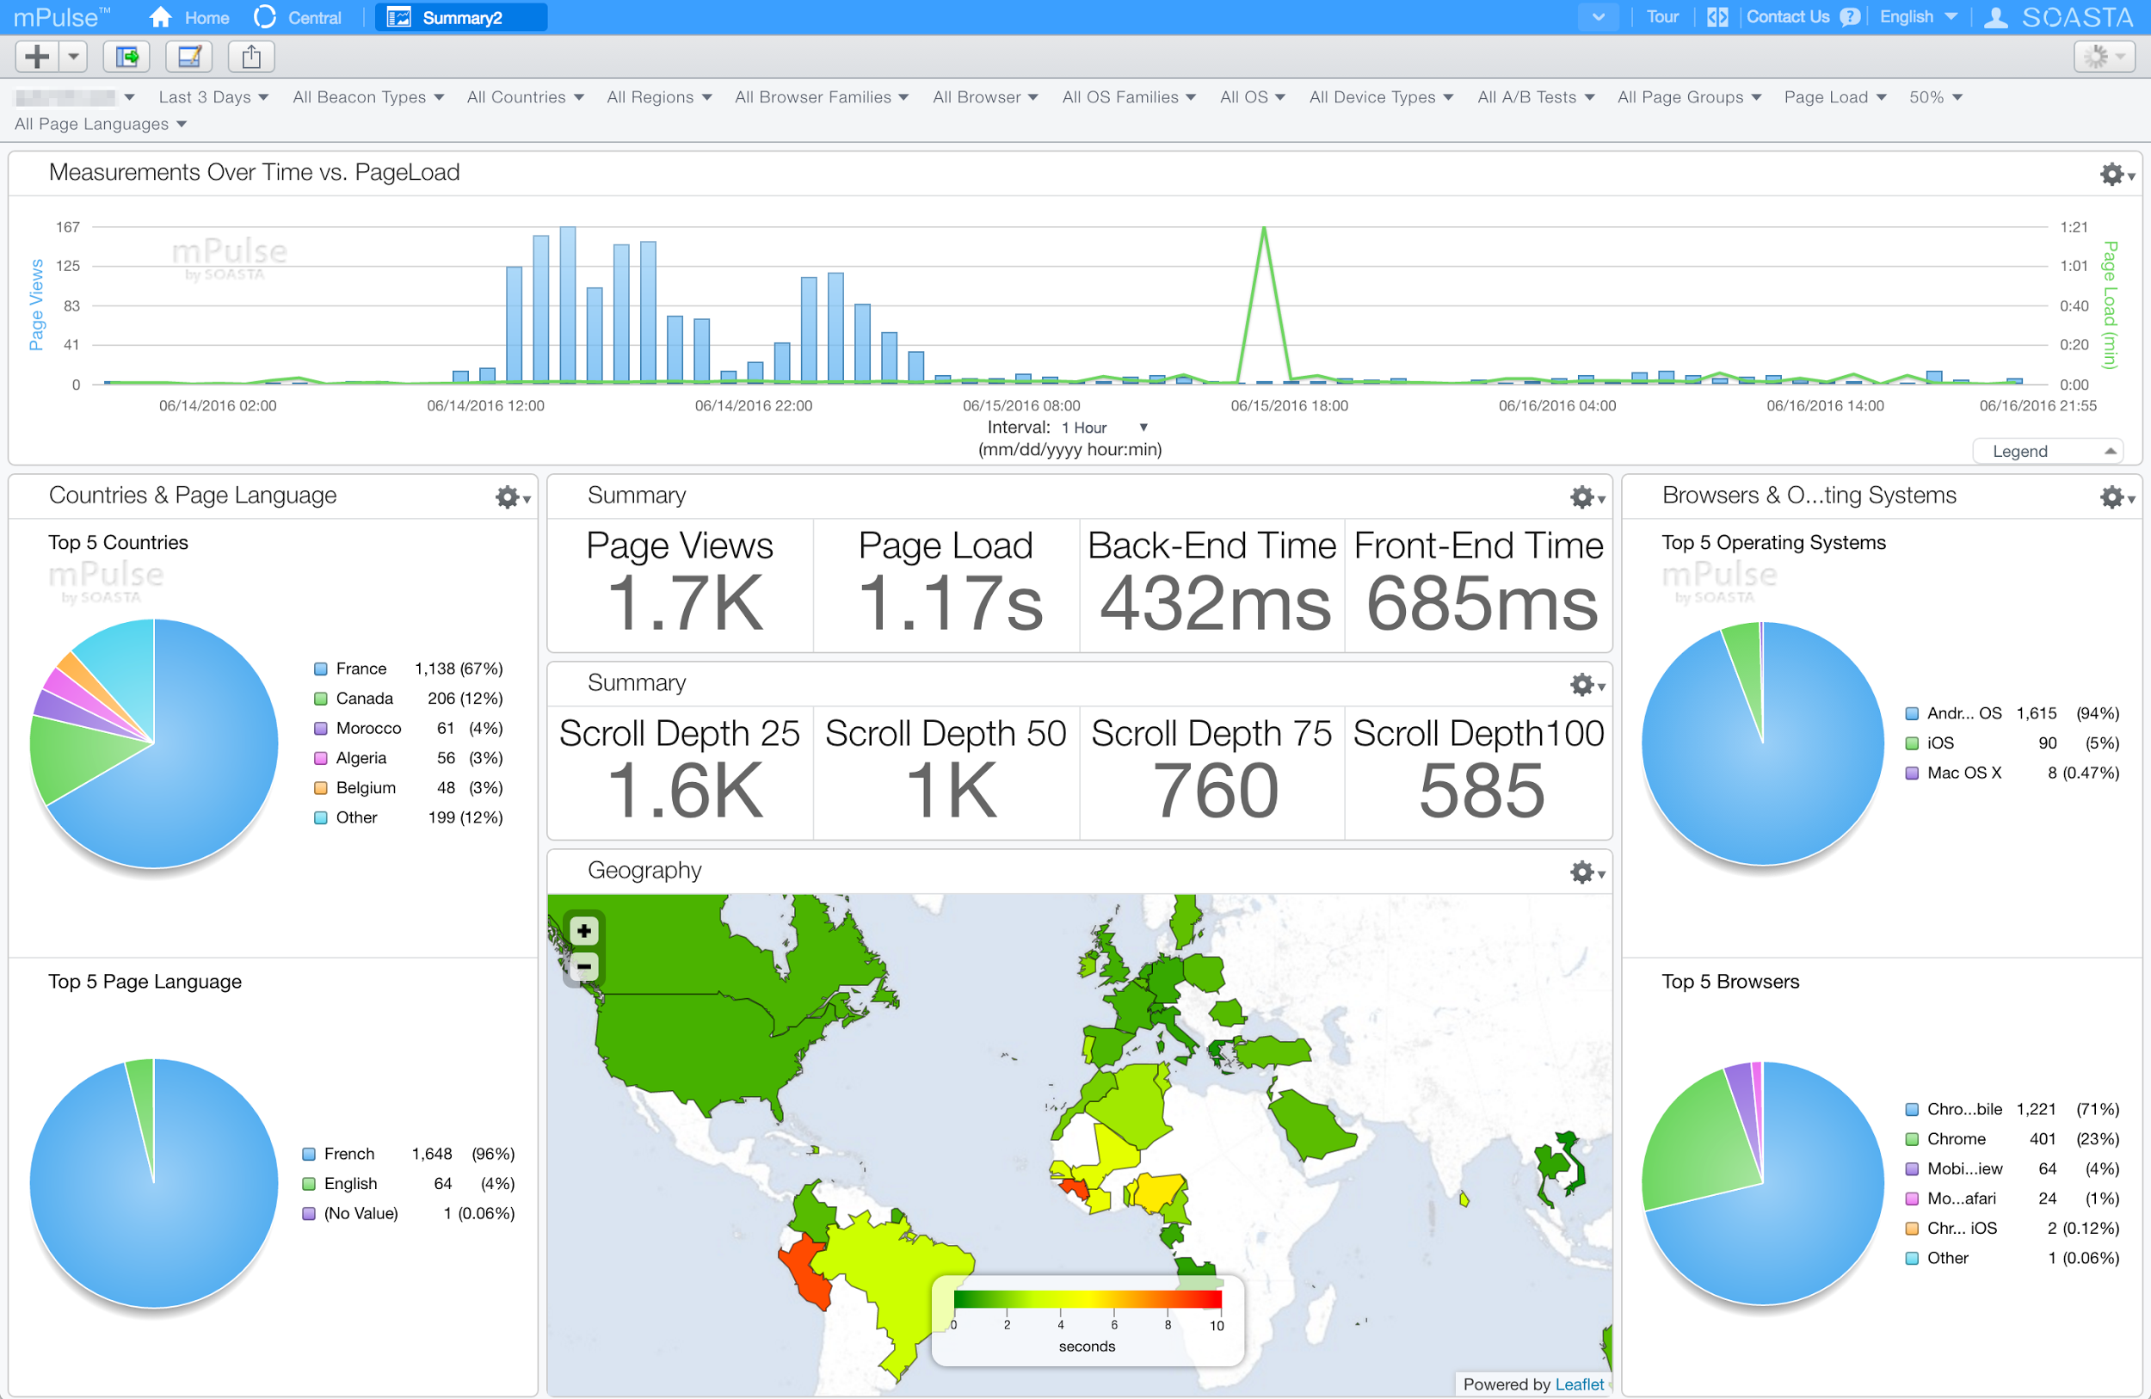
Real-world RUM data

Slide 36
Real-World Data
RUM analysis of an AMP-enabled website
News website with blog / articles
30+ days of data
Thousands of articles with both AMP and non-AMP visitors

Slide 37
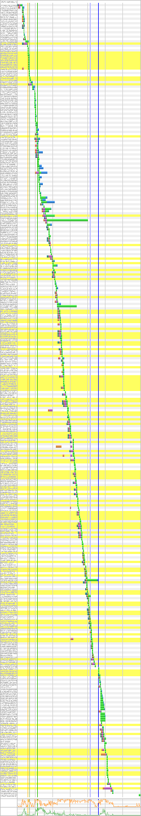
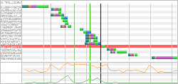
Sample Regular vs. AMP Page
Regular Site
350 Requests
3.2 MB data
1,258ms First Byte
34.9s Page Load
6701 Speed Index
AMP
19 Requests
250 KB data
598ms First Byte
3.6s Page Load
1790 Speed Index

Slide 38
Sample Regular vs. AMP Page
Regular Site
Interactive Nav
High Res Images
Other Content Links
Third Party Content
AMP
Simple Nav
Article Text
Hero Image(s)
No Third Parties

Slide 39
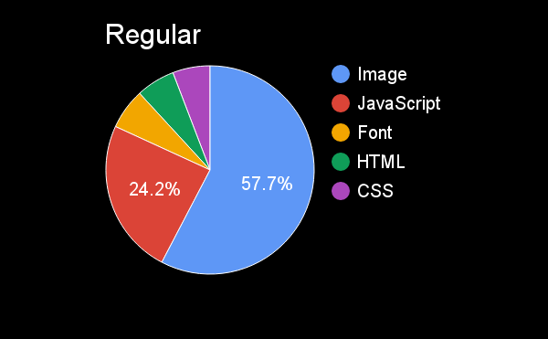
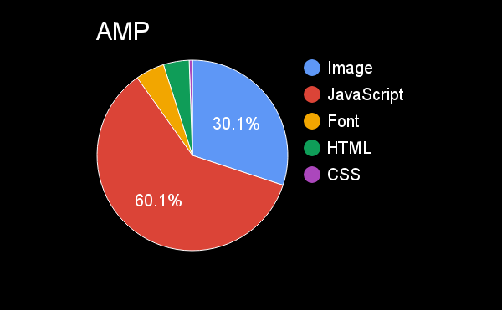
Sample Page Content

Slide 40
RUM Data

Slide 41
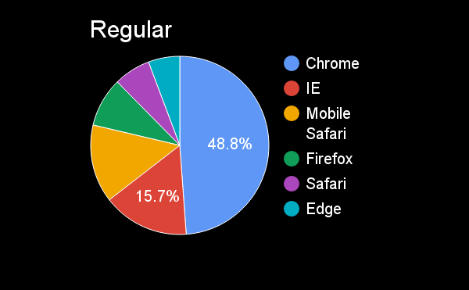
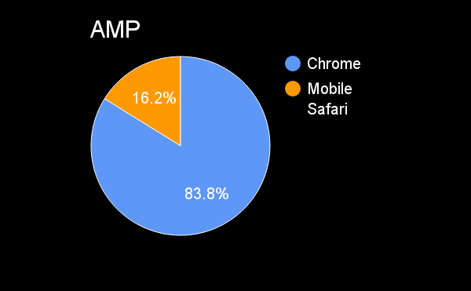
Real-World Data: Browsers

Slide 42
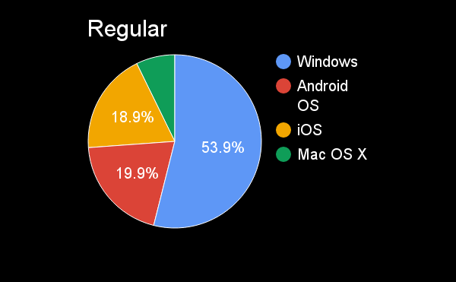
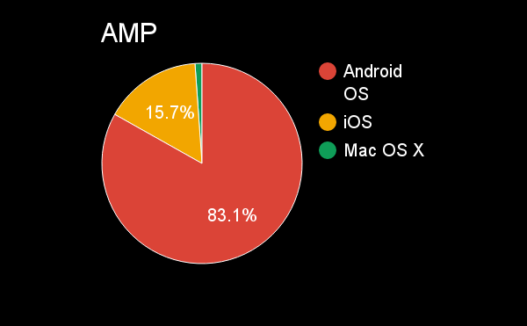
Real-World Data: OS

Slide 43
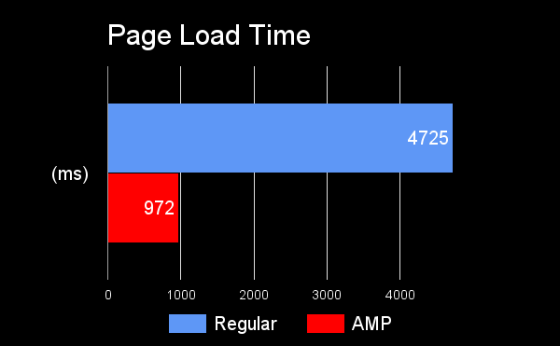
Real-World Data: Page Load Times
3.8x
faster

Slide 44
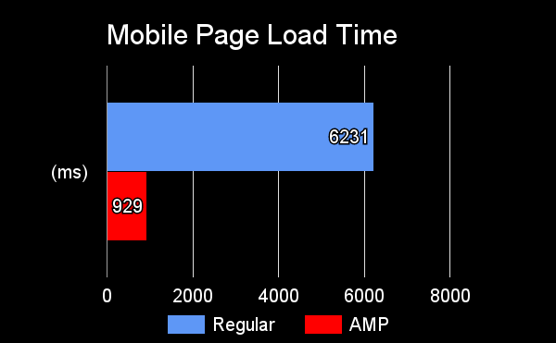
Real-World Data: Mobile Load Times
5.7x
faster

Slide 45
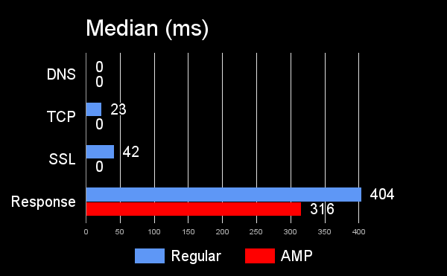
Real-World Data: Timings
Notes:
SSL: Edge locations
Response because of CDN caching static content versus regular site possibly not caching (dynamic generation)

Slide 46
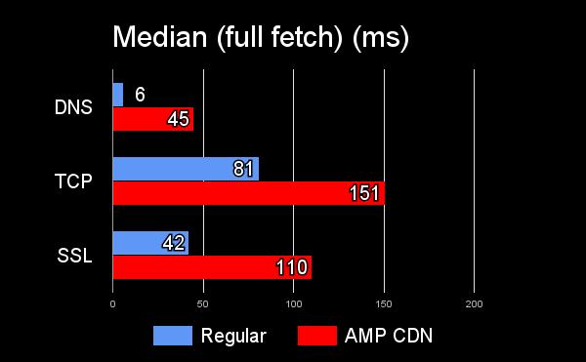
Real-World Data: Timings
Notes:
SSL: Edge locations
Response because of CDN caching static content versus regular site possibly not caching (dynamic generation)

Slide 47
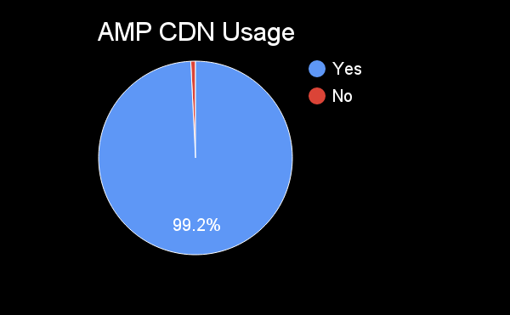
Real-World Data: AMP CDN Usage
Notes:
Non-CDN usage probably from developer machines or bots

Slide 48
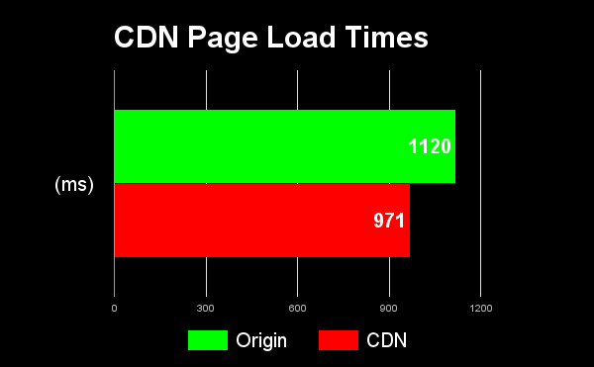
Real-World Data: CDN Load Times
13%
faster
Notes:
Static content vs dynamic content

Slide 49
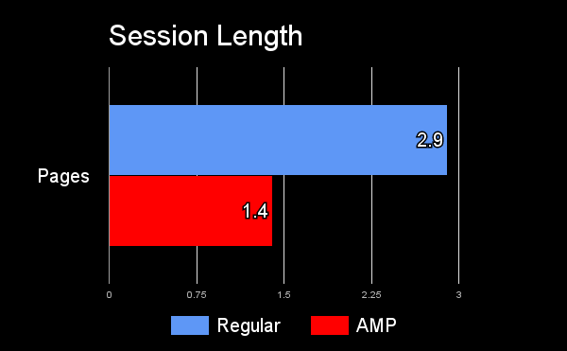
Real-World Data: Session Length
48%
less
pages
Notes:
AMP pages for a single site in a carousel

Slide 50
Real-World Data: Bounce Rate
Regular
AMP
58%
82%

Slide 51
Real-World Data: Transitioning
Only 3% of AMP visitors transitioned to non-AMP URL

Slide 52
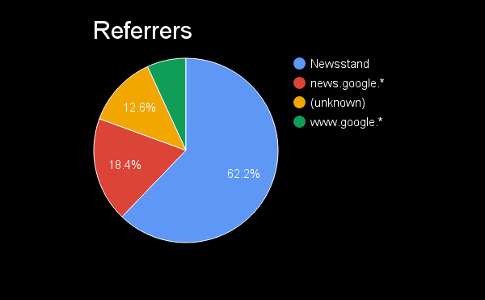
Real-World Data: Referrers

Slide 53
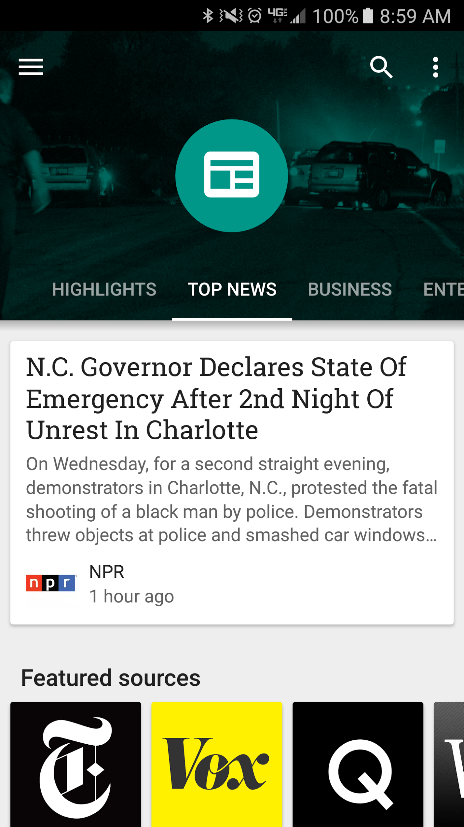
Real-World Data: Play Newsstand

Slide 54
Conclusions
AMP is a forcing function for best practices
AMP is a great way to get rid of your third-party bloat
You could get much of the same performance by applying the same optimizations to your own site without AMP
AMP CDN can give you a free performance boost
Business / SEO benefits
Notes:
Slow TTFB due to server performance.
CDN malfunction. (cdn edge location not near user)
Network delays and poor cellular throughput.
Slow mobile device hardware.
Resources not optimized for mobile (large images).
Fonts can delay page rendering (default timeout of 3s).

Slide 55
Do we need AMP?
Downsides:
Additional development resources to build
Technical resources to maintain
Hand-Tuning
CPP: https://timkadlec.com/2016/02/a-standardized-alternative-to-amp/
Facebook Instant Articles (analytics sandboxed)

Slide 56
Future
Features we’d like to implement
Collect ResourceTiming (amphtml PR 3593)
Trigger / collect UserTiming
Collect an indication that the page was prerendered and time spent in prerender

Slide 57
Thank You
https://slideshare.net/nicjansma/amp-does-it-really-make-your-site-faster
https://github.com/querymetrics/amp-analytics-demo

